Slide 1

School of Chemical Engineering
Effective Radiator Coolant Management and Recycle
Rahul Khade (TCH 81)
Guide:
Dr.Kunjan Junghare

Slide 2
Index
Project Title
Literature Review
Objective
Result
Conclusion

Slide 3
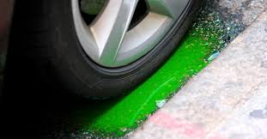
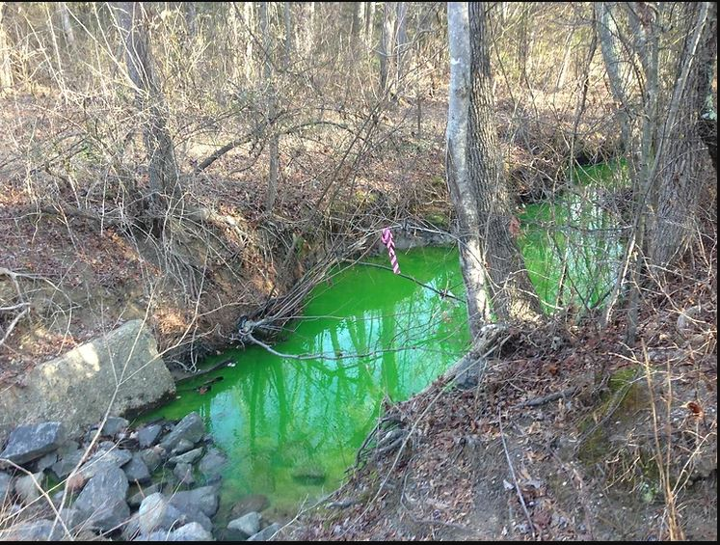
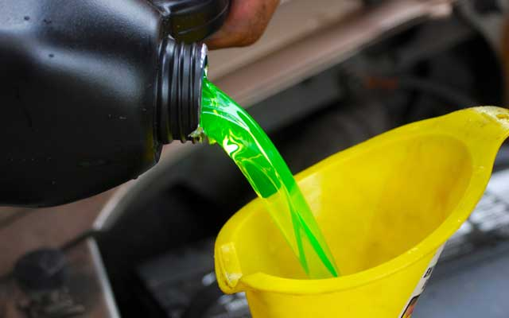
Introduction
Radiator coolant, also known as antifreeze, plays a crucial role in maintaining the temperature of internal combustion engines.

Slide 4
Abstract
The challenge is to investigate and develop an optimized recycling process that encourages automotive users and service centers to recycle radiator coolant effectively, reducing environmental impact and promoting resource conservation. Coolant contains hazardous substances such as ethylene glycol or propylene glycol, heavy metals, and contaminants that can contaminate soil and water bodies if not handled responsibly. Moreover, the demand for virgin coolant production leads to resource depletion and increased greenhouse gas emissions.

Slide 5
Literature Review
Paper | Author | Year | Conclusion
Used Antifreeze Handling, Recycling, And Disposal | Lara M. Dando and Michael P. Vogel, E.D. | February 1996 | Overview on Handling and recycling of Used Coolant.
Modern Reverse Osmosis Recycling of Used Engine Coolant | Edward R. Eaton,Richard DeGruccio,Marvin E. Haddock,William Kughn. | 1997 | Reverse Osmosis is capable of extracting purified water and glycol from waste stream of used engine coolant.
Antifreeze Recycling using the Glyclean System | Robert C. Miller, Jr | 1995 | Glyclean additives are used to produce recycled radiator coolant.
Using Reverse Osmosis to recycle used Engine Coolant | John R. Huff | 1992 | The Paper Examines RO as a means of recycling Ethylene glycol-based Engine Coolant

Slide 6
Literature Review
Paper | Authur | Year | Conclusion
Evaluation of Filtration and Distillation Methods for Recycling Automotive Coolant. | Paul M. Randall & Arun R. Gavaskar | 05 Mar 2012 | cost-effective alternative to off-site disposal of spent coolant. The main concern in the chemical filtration technology
Development and Evaluation of a Multi-stage Chemical Process for Used Antifreeze/Coolant Recycling and Re Inhibition. | A. V. Gershun, S. M. Woodward, and P. M. Woyciesjes | March 1993 | Extensive laboratory and vehicle service testing has been conducted on the Multi-Stage Chemical Process for used antifreeze/coolant recycling and rehibition, and from the data shown in this paper

Slide 7
Literature Review
Paper | Authur | Year | Conclusion
Recycling and Propylene Glycol Engine Coolant | Steven A. Schwartz. | February 26-29,1996. | vacuum distillation and filtration/dual-resin deionization.
Launch. Distillation Recovery of Ethylene Glycol from Used Coolants Using Vacuum Distillation | C.Kenneth Launch | September 1992 | Recovery of propylene glycol using Vacuum Distillation.
Waste Antifreeze characterization | Laurie wunder | August 1991 | Toxicity characteristics leaching Procedure
Single Rehibition Additive package for Antifreeze recycling system | Dwayne Davis | February 1996 | To develop a single rehibition additive package(SRP) for current recycling system

Slide 8
Problem Statement
Many automotive users and service centers dispose off used coolant in surrounding. As a result, a considerable volume of coolant waste ends up in landfills, wastewater systems, or is released into the environment, leading to soil and water contamination, adverse effects on wildlife, and potential health risks for humans.

Slide 9
Project Implementation
Collection and Segregation
Analysing Physical & Chemical Properties
Treatments
Quality Testing
Replenishment and Reuse

Slide 10
Methodologies
Filtration: To remove contaminants such as dirt, debris, and metal particles.
Distillation: To separate the water from the chemical additives.
Reverse Osmosis: To separate water from the coolant's chemical components.
Ion Exchange: To remove impurities from the coolant. The resin absorbs contaminants and releases clean coolant.
Biological Treatment: Treating the coolant with microorganisms that can break down contaminants and impurities.
Vacuum Evaporation: Coolant is evaporated at a low pressure to separate the water from the chemical additives.
Centrifugation: Centrifuges can be used to separate solid particles and debris from the coolant.

Slide 11
Objectives
Objectives
To Create a System Which Recycles The Used Radiator Coolant.
To Meet ASTM Standards of our Product.
To Produce / Generate New Radiator Coolants From Used Radiator Coolant at any Cost.
To Prevent Disposals of Radiator Coolant Into The Environment.
To Reduce Demand of Virgin/New Radiator Coolant.
To make our system feasible.

Slide 12
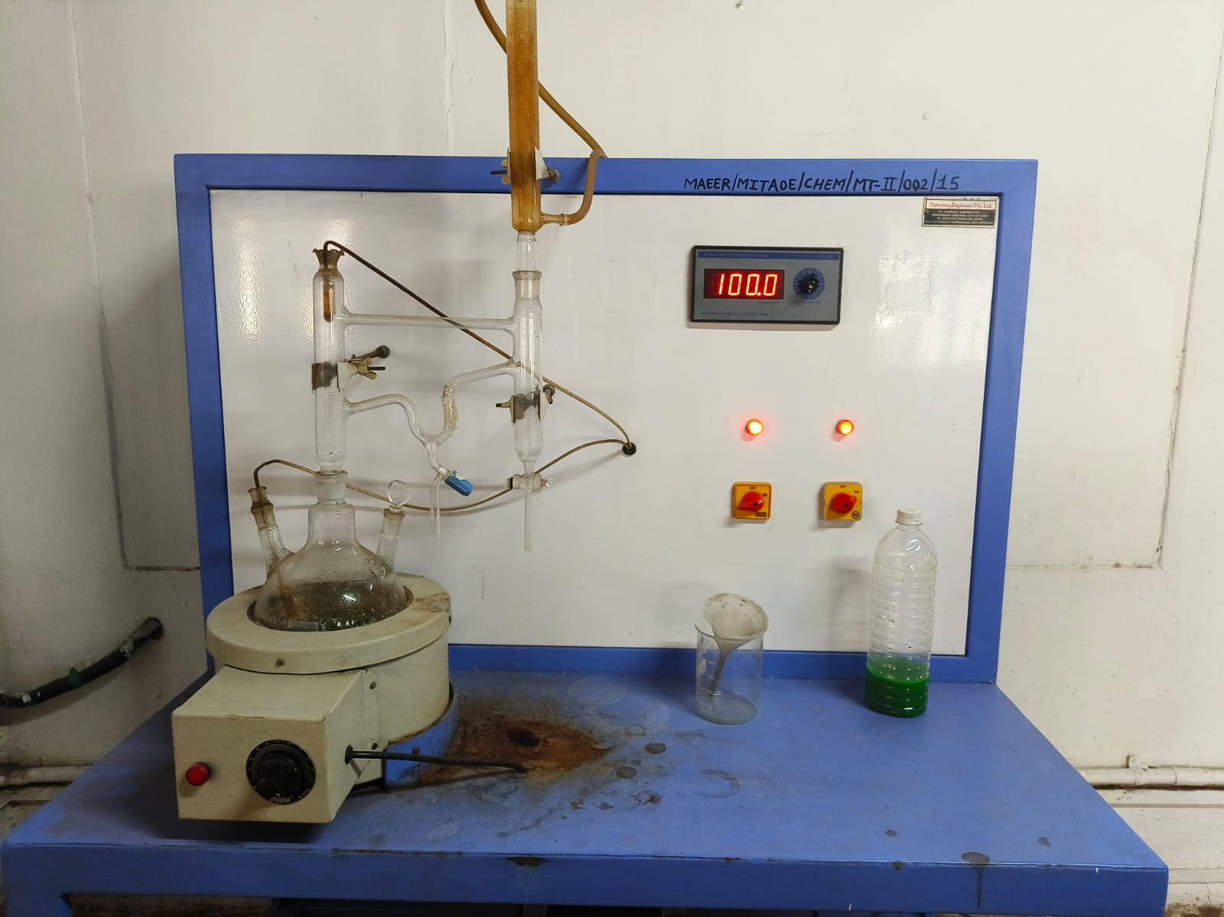
Experimental Setup
Fig 1: Vapour Liquid Equilibrium Setup for Separation of Water from Glycol.

Slide 13
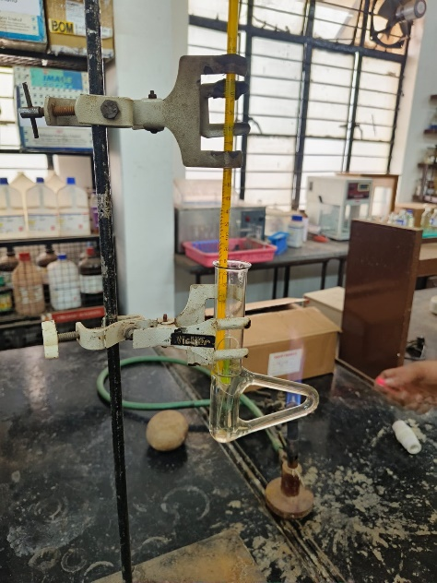
Experimental Setup
Fig 2: Boiling Point Setup for measuring the Temperature of Sample.

Slide 14
Results
Analysis Result Before
Sample | Specific Gravity | pH | Boiling Point (Degrees)
1 | 1.01 | 8 | 130
2 | 0.9615 | 7.8 | 102
3 | 0.9852 | 7.6 | 105
4 | 0.9267 | 7 | 101
5 | 0.9512 | 7.3 | 106

Slide 15
Results
Analysis Result After
Sample | Specific Gravity | pH | Boiling Point (Degrees)
1 | 1.01 | 8 | 130
2 | 1.00 | 8.2 | 132
3 | 0.9952 | 8 | 129
4 | 1.02 | 7.7 | 131
5 | 0.9900 | 7.9 | 133

Slide 16
Conclusion
Reduction of Environmental Impact: The way that radiator coolant is now disposed of greatly pollutes the environment.
Economic Viability: The research of the economics showed that some recycling systems are both environmentally and financially sustainable over the long term.
Consequences: The results have consequences for environmental regulations as well as the automotive sector. Using effective coolant recycling techniques puts businesses in a position to meet ever-tougher environmental regulations while also being compliant with corporate social responsibility.

Slide 17
References
Lara M. Dando and Michael P. Vogel, E.D. Used Antifreeze Handling, Recycling, And Disposal. February 1996.
Edward R. Eaton,Richard DeGruccio,Marvin E. Haddock,William Kughn. Modern Reverse Osmosis Recycling of Used Engine Coolant. 1997.
Robert C. Miller, Jr. Antifreeze Recycling using the Glyclean System.
Paul M. Randall & Arun R. Gavaskar. Evaluation of Filtration and Distillation Methods for Recycling Automotive Coolant. 05 Mar 2012.
A. V. Gershun, S. M. Woodward, and P. M. Woyciesjes. Development and Evaluation of a Multi-stage Chemical Process for Used Antifreeze/Coolant Recycling and Re Inhibition. March 1-5, 1993.
Steven A. Schwartz. Recycling and Propylene Glycol Engine Coolant February 26-29,1996.
C.Kenneth Launch. Distillation Recovery of Ethylene Glycol from Used Coolants Using Vacuum Distillation. September 14-17, 1992.
Dwayne Davis. Single rehibition additive package for antifreeze recycling system.
John R . Huff. Using Reverse Osmosis to recycle used engine Coolant. 1992.
Laurie Wunder. Waste Antifreeze characterization .August 1991.

Slide 18
Thank You

